Slide 1

19CS2211 - Software Engineering
Test Driven Development
Session 23

Slide 2
Outline
Agenda:
Test Driven Development (TDD)
TDD – Mantra
TDD Versus Traditional Testing
Agile Model Driven Development (AMDD)
Revision Questions

Slide 3

Old School Approach
Design
Code
Test

Slide 4
New School Approach
Design
Test
Code

Slide 5
What is TDD?
TDD is a technique for building software that guides software development by writing tests
TDD is NOT primarily about testing or development (i.e., coding)
It is rather about design – where design is evolved through refactoring
Developer write unit tests (NOT testers) and then code

Slide 6
Performing TDD - Mantra
Failing Test(s)
RED
RE-FACTOR
GREEN
Passing Test(s))

Slide 7
Step 1: Write test that fails
Red: Write a little test that doesn’t work, perhaps doesn’t even compile at first
Fail

Slide 8
Step 2: Get code working to pass test
Green: Make the test work quickly, committing whatever necessary in the process
Pass

Slide 9
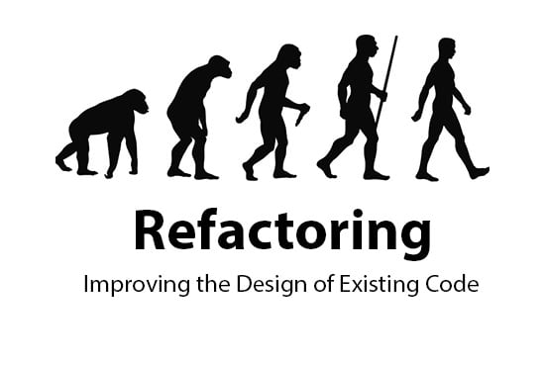
Step 3: Clean-up and Refactoring
Refactor: Eliminate all the duplication and smells created in just getting the test to work

Slide 10



Always leaves the code cleaner than you found it!
Always Remember Clean Code
Always Remember Clean Green

Slide 11
Clarification about TDD
TDD is neither about "Testing" nor about "Development".
• TDD does not mean "write some of the tests, then build a system that passes the tests”
• TDD does not mean "do lots of Testing."

Slide 12
TDD Versus Traditional Testing
TDD – Specification Technique & Ensures thoroughly source code is tested
Traditional Testing(TT) – Uncover error – solve it
TDD – Ensures meet requirement – it builds confidents about system
TDD – focus on production code – verifies the testing work properly or not
TT – focus on test case design
TDD – Every single line of code is tested
TT – Not all lines are tested
Notes:
e

Slide 13
TDD & TT
The combination of both TT & TDD leads to the importance of testing the system rather than perfection of the system.
• In Agile Modeling (AM), leads to the "test with a purpose".
Should know why are testing something and what level its need to be tested.

Slide 14
Levels of TDD
Levels of TDD
Acceptance TDD
Developer TDD
It Tests – Requirement Specifications
Write production code – to fulfill the acceptance test
It is called as Behavioral Driven Development (BDD)
Unit Test – focus on functionality of the system
Production Test
It is simply called TDD

Slide 15


Goal of ATDD & TDD
Without TDD
With TDD
Main goal of ATDD and TDD:
To specify detailed, executable requirements for solution on a just in time (JIT) basis.
JIT means taking only those requirements in consideration that are needed in the system. So increase efficiency.

Slide 16
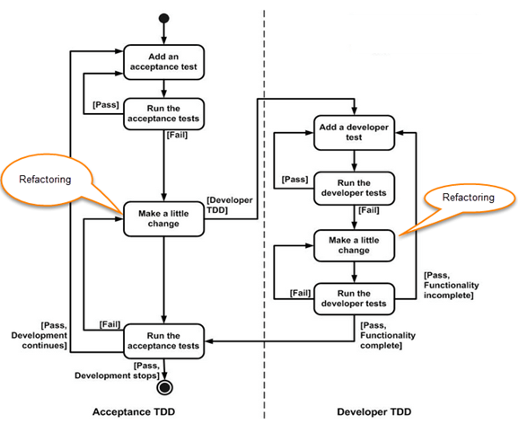
ATDD & DTDD

Slide 17
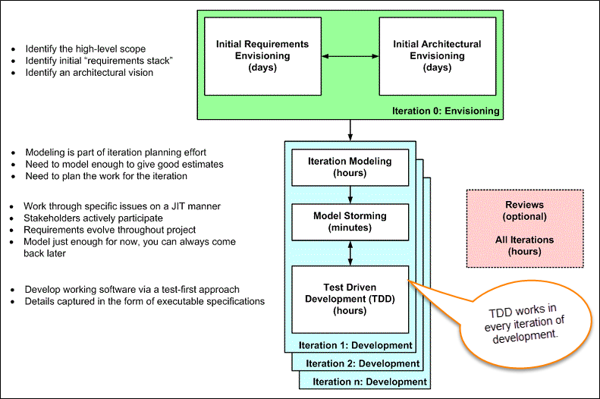
Agile Model Driven Development (AMDD)
AMDD addresses the Agile scaling issues that TDD does not.

Slide 18
Iteration 0: Envisioning
Envisioning
Initial Requirements Envisioning
Initial Architectural Envisioning
Main goal is to explore
1. Usage Model
2. Initial Domain Model
3. User Interface Model
Main goal is to explore
Set technical directions for projects
Technology diagrams
User Interface Flow
Domain Models
Change Cases

Slide 19
Iteration Modeling
• Team must plan the work that will be done for each iteration
• Agile process is used for each iteration - new work item will be added with priority in each iteration
• Higher prioritized work – taken into consideration
• Work items added – reprioritized / removed from stack
• Team discusses – to implement each requirement. Modeling is used for this purpose
• Modeling analysis and design is done for each requirement which is going to implement for that iteration

Slide 20
Model storming (Just in time modeling)
• Modeling session involves a team of 2/3 members
• One team member will ask another to model with them. Session will take 5 to 10 minutes.
• Explore issues until – find the main cause of the problem.
• Just in time, if one team member identifies the issue - wants to resolve – then take quick help of other team members.
• Other group members then explore the issue and then everyone continues on as before.
• It is also called as stand-up modeling or customer QA sessions.

Slide 21
Test Driven Development
It promotes confirmatory testing of application code and detailed specification.
Both acceptance test (detailed requirements) and developer tests (unit test) are inputs for TDD.
TDD makes the code simpler and clear. It allows the developer to maintain less documentation.

Slide 22
Revision Questions
Define TDD.
Outline the steps need to performed for TDD Test.
Distinguish TDD and Traditional Testing
Explain in detail about Acceptance Testing and Developer Testing.
Distinguish Scaling TDD and AMDD.
Explain the Life cycle of AMDD.

Slide 23
Thank You

